Slide 1

Arduino PWM
Thainan Santos Theodoro
Universidade Federal de Ouro Preto
João Monlevade, MG
E-mail: thainan.theodoro@ufop.edu.br
Notes:
Agradecimentos: Orientadores, banca interna e externa;
Leitura do Título;
inerge217

Slide 2
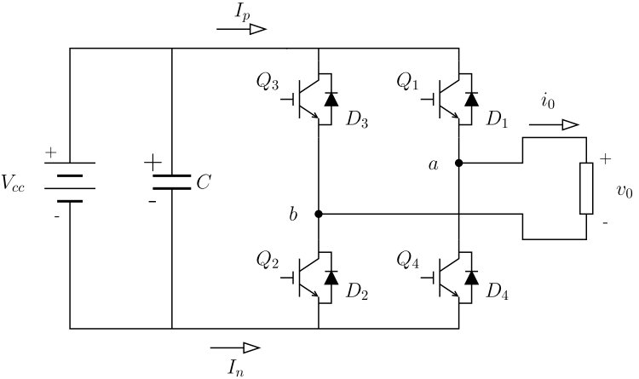
The H-bridge
H-bridge working as Voltage Source Inverter (VSI). Related to the nature of the source connected to DC terminals.
The switches in the same branch are complementary.
The anti-parallel diodes allow bidirectional electric current.
Figure – Single-phase H-bridge inverter.

Slide 3
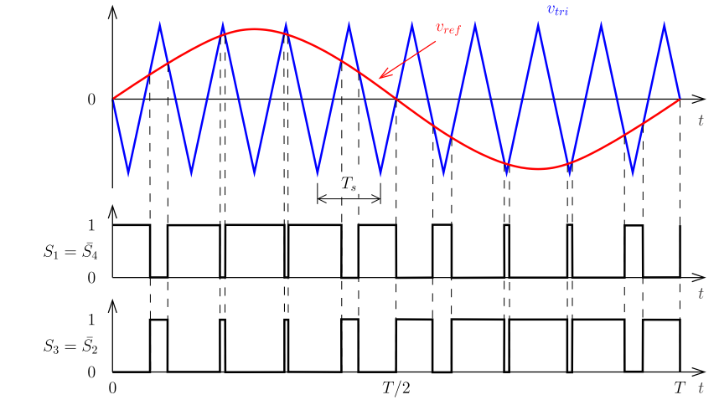

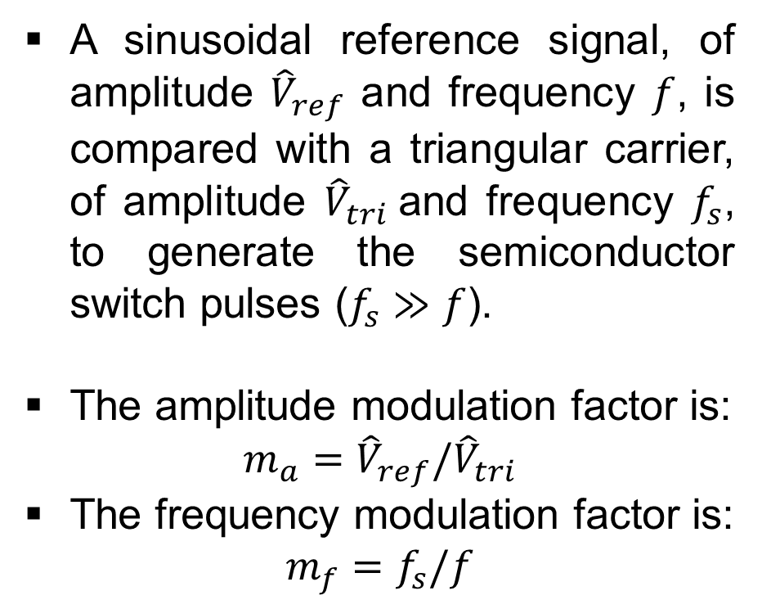







Typical PWM implementation
The sinusoidal PWM
$$v_{ref}={\hat{V}}_{ref}\sin\left(ωt+θ\right)$$
A sinusoidal reference signal, of amplitude ${\hat{V}}_{ref}$ and frequency $f$, is compared with a triangular carrier, of amplitude ${\hat{V}}_{tri}$and frequency $f_{s}$, to generate the semiconductor switch pulses ($f_{s}≫f$).
The amplitude modulation factor is:
$$m_{a}={\hat{V}}_{ref}/{\hat{V}}_{tri}$$
The frequency modulation factor is:
$$m_{f}=f_{s}/f$$
$$+$$
$$S_{1}$$
$$v_{tri}$$
$$−$$
$$S_{4}$$
Sinusoidal PWM waveforms
$$S_{1}$$
$$S_{4}$$

Slide 4

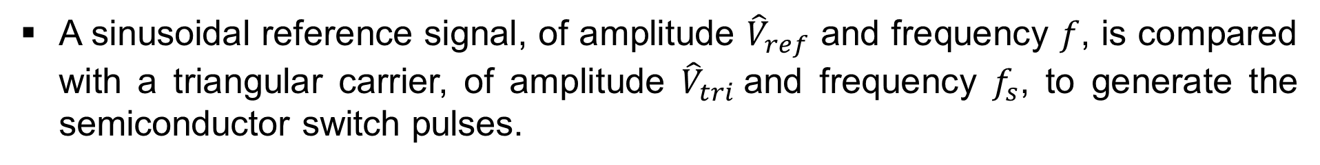








The sinusoidal PWM
A sinusoidal reference signal, of amplitude ${\hat{V}}_{ref}$ and frequency $f$, is compared with a triangular carrier, of amplitude ${\hat{V}}_{tri}$and frequency $f_{s}$, to generate the semiconductor switch pulses.
Figure – Typical PWM implementation
Figure – PWM waveforms
$$v_{ref}={\hat{V}}_{ref}\sin\left(ωt+θ\right)$$
$$v_{tri}$$
$$+$$
$$S_{1}$$
$$D$$
$$v_{tri}$$
$$−$$
$$S_{2}$$
$g$

Slide 5
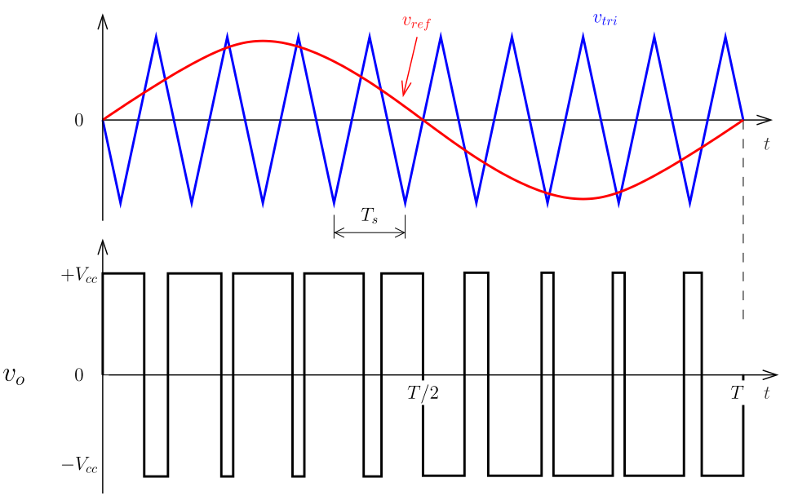
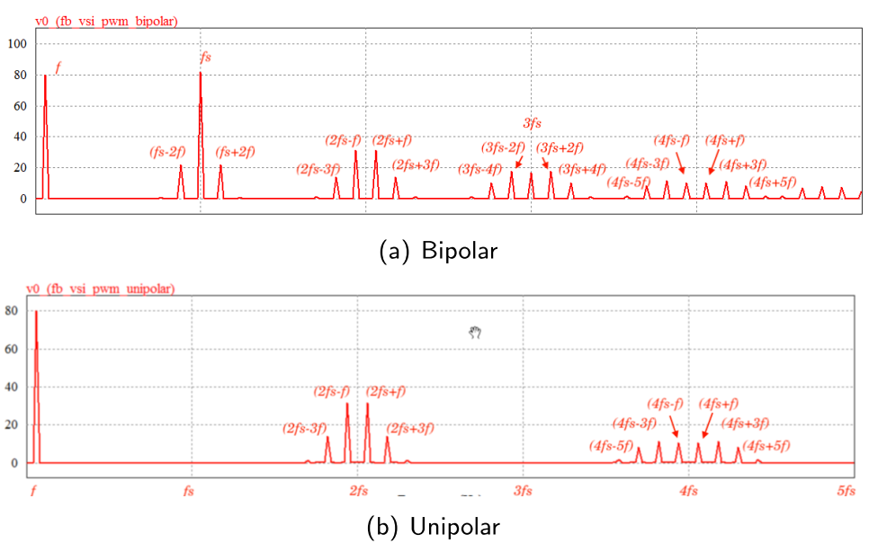
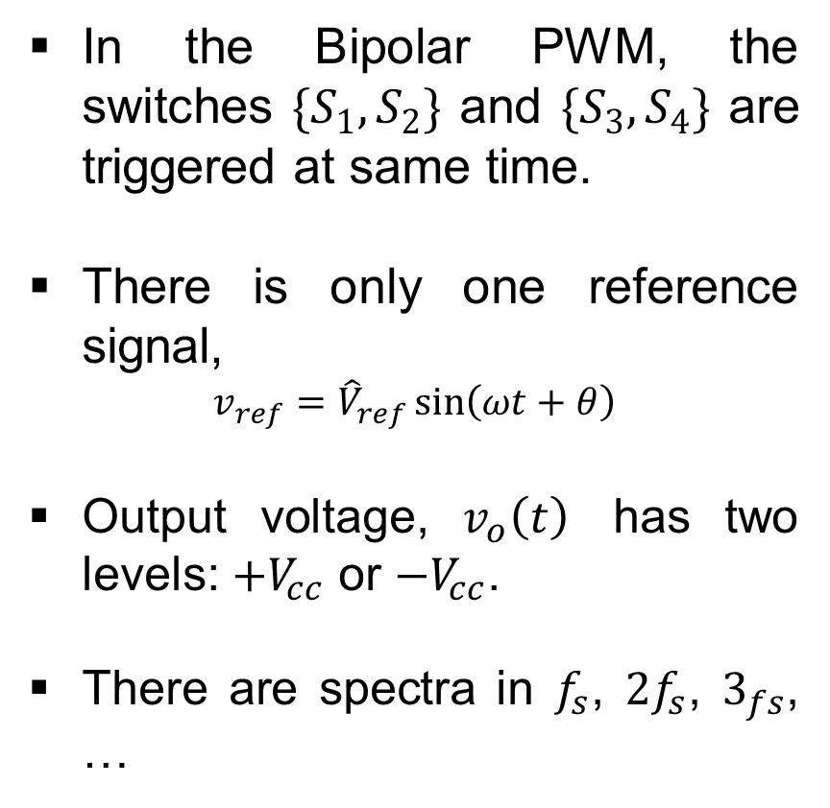
The Bipolar PWM
The Bipolar PWM
In the Bipolar PWM, the switches $\{S_{1},S_{2}\}$ and $\{S_{3},S_{4}\}$ are triggered at same time.
There is only one reference signal,
$$v_{ref}={\hat{V}}_{ref}\sin\left(ωt+θ\right)$$
Output voltage, $v_{o}\left(t\right)$ has two levels: $+V_{cc}$ or $−V_{cc}$.
There are spectra in $f_{s}$, $2f_{s}$, $3_{fs}$, …

Slide 6
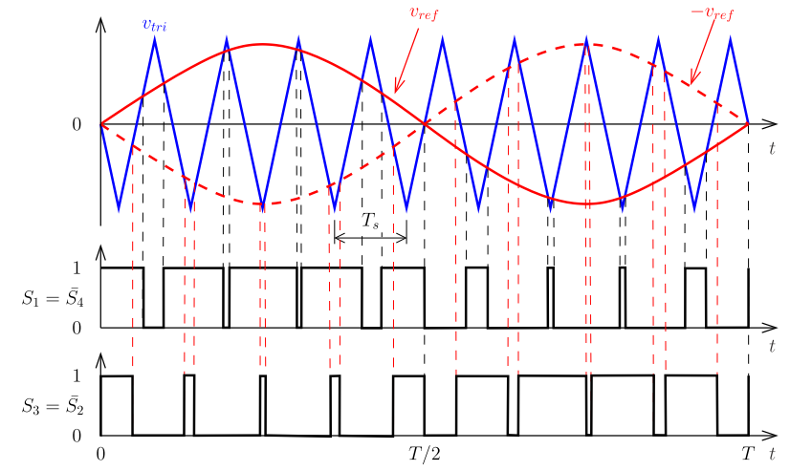
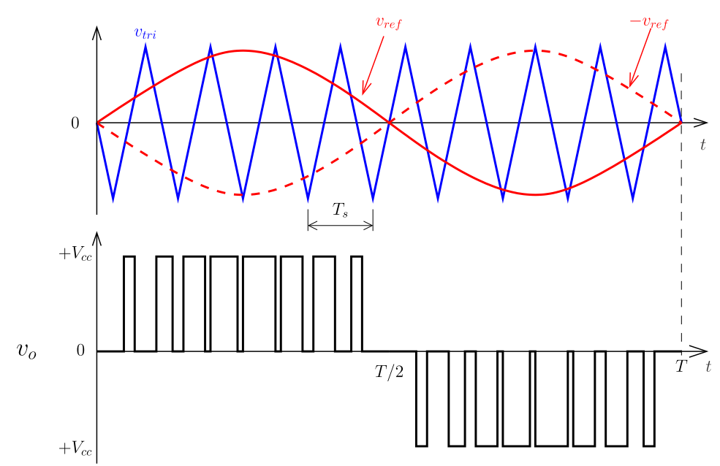
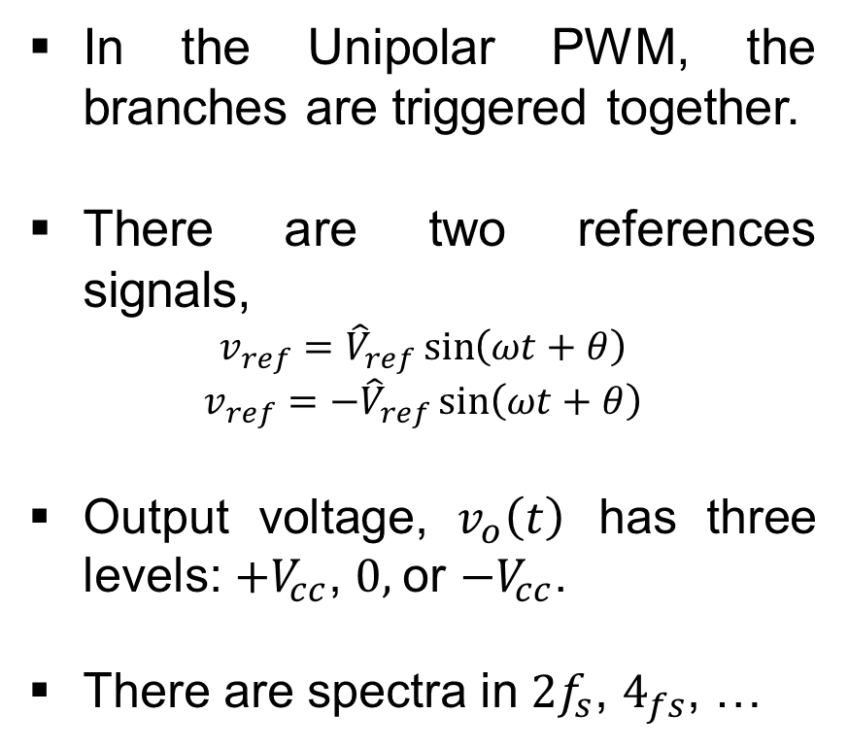
The Unipolar PWM
The Unipolar PWM
In the Unipolar PWM, the branches are triggered together.
There are two references signals,
$$v_{ref}={\hat{V}}_{ref}\sin\left(ωt+θ\right)$$
$$v_{ref}=−{\hat{V}}_{ref}\sin\left(ωt+θ\right)$$
Output voltage, $v_{o}\left(t\right)$ has three levels: $+V_{cc}$, $0,$or $−V_{cc}$.
There are spectra in $2f_{s}$, $4_{fs}$, …

Slide 7
Arduino PWM: AnalogWrite()
The analogWrite() function on Arduino does not generate a true analog signal, as it lacks a DAC (Digital-to-Analog Converter). Instead, it outputs a PWM (Pulse Width Modulation) signal.
Internal Functioning of analogWrite():
Checks if the pin supports PWM.
Configures the corresponding Timer.
Adjusts the duty cycle using the OCRnX register.
However, this function operates at fixed frequencies of 490 Hz or 980 Hz. It is unsuitable for power converters.
Table - Arduino Uno, Nano, and Pro Mini.
Pins | Timer | Freq.
3, 11 | Timer 2 | 490 Hz
5, 6 | Timer 0 | 980 Hz
9, 10 | Timer 1 | 490 Hz

Slide 8
Arduino PWM
PWM can be generated in a microcontroller using the following elements:
Timer/Counters – Used to track time and define the PWM period.
Comparison Mechanisms – The counter value is compared against a predefined threshold to determine the duty cycle.
Interrupt Service Routine (ISR) – Can be used to update the PWM signal dynamically when a timer reaches a specific value.

Slide 9
Timer/Counters
The Timer/Counter 1 in microcontrollers typically operate in four main modes:
Mode | Main Characteristic | Suitable for Sine PWM?
Normal Mode | Timer counts up until overflow, then resets to zero. | ❌ Not suitable
Clear Timer on Compare Match (CTC) Mode | Timer resets when it matches a compare value (OCRx); used for fixed timing events. | ❌ Not suitable
Fast PWM Mode | Timer counts up and resets quickly; high frequency and resolution PWM generation. | ✅ Yes
Phase Correct PWM Mode | Timer counts up and down for symmetric PWM; better frequency stability. | ✅ Yes
Phase and Frequency Correct PWM Mode | Similar to Phase Correct but allows adjusting both frequency and phase precisely. | ✅ Yes

Slide 10
Normal Mode
The timer counts up until it overflows and resets to zero.
No automatic waveform generation.
Often used for time delays with interrupts.
Table – Technical Characteristics.
Figure – Counter.
Timer | Bit Resolution | Counting Range
Timer 0 | 8-bit | 0 to 255 (0x00 to 0xFF)
Timer 1 | 16-bit | 0 to 65,535 (0x0000 to 0xFFFF)
Timer 2 | 8-bit | 0 to 255 (0x00 to 0xFF)

Slide 11
Clear Timer on Compare Match (CTC) Mode
In CTC, the timer counts up until it reaches a predefined compare value stored in the OCRnA or ICR1 (depending on mode).
ICR1’
ICR1’’’
ICR1’’

Slide 12
Fast PWM Mode
The timer TCNTn counts from 0 to a predefined TOP value (e.g., ICR1), then resets, generating a sawtooth waveform. For example, the OCR1A sets the duty cycle, and OC1A outputs the PWM signal.
Fast PWM Mode
Example: if ICR1=16,000 and OCR1A = 4,000, then Timer 1 produces a PWM signal in OC1A, which is Arduino pin 9.
The updates of ICR1 and OCR1A are made at the BOTTOM of counter.
ICR1
TCNTn
OCR1A
OC1A

Slide 13
Fast PWM Mode
D variation
Freq. variation
1600
1600
ICR1
ICR1
800
OCRA1
900
OCRA1
400
400
OCRA1’
OCRA1’
COUNT
COUNT
400
OC1A
OC1A

Slide 14
Phase Correct PWM Mode
The timer is up/down using predefined TOP value (e.g., ICR1), generating a triangular waveform. For example, the OCR1A sets the duty cycle, and OC1A outputs the PWM signal.
Figure – Phase Correct PWM Mode
ICR1
COUNT
The updates of ICR1 and OCR1A are made at the TOP of counter.
OCR1A
200
OC1A

Slide 15
Phase Correct PWM Mode
D variation
TOP (ICR1) variation
ICR1
1600
1600
1600
ICR1
800
OCRA1
900
OCRA1
400
400
OCRA1’
OCRA1’
COUNT
COUNT
OC1A
OC1A

Slide 16
Phase and Frequency Correct PWM Mode
The timer is up/down using predefined TOP value (e.g., ICR1), generating a triangular waveform. For example, the OCR1A sets the duty cycle, and OC1A outputs the PWM signal.
Figure – Phase and Frequency Correct PWM Mode
ICR1
COUNT
The updates of ICR1 and OCR1A are made at the BOTTOM of counter.
OCR1A
200
OC1A

Slide 17
Phase and Frequency Correct PWM Mode
D Variation
TOP (ICR1) variation
1600
1600
1600
ICR1
ICR1
800
OCRA1
900
OCRA1
400
400
OCRA1’
OCRA1’
COUNT
COUNT
OC1A
OC1A

Slide 18
Sine Wave and lookup table
Due to computational burden, the sinusoidal reference is based on a lookup table to avoid runtime calculations.
fo = 50; % fundamental freq.
mf = 15; % freq. modulation factor
fclk = 16e6; % microcontroller freq.
N = 1; % prescaler timer1
% Project
ftimer = fclk/N;
fpwm = mf*fo; % freq. pwm
% Some calculations
TOP = ceil(ftimer/fpwm - 1);
fpwm = ftimer/(N*(1+TOP));
Tpwm = 1/(fpwm);
To = 1/fo;
mf = fpwm / fo;
% lookup table
Nperiods = 1;
Ns = Nperiods*ceil( (To / Tpwm) );
n = 0 : Ns - 1;
lookupSin = sin(2*pi*fo*n*(To/Ns))';

Slide 19
Offset sine wave
Since timer counters only produce positive values (e.g., 0 to 255), the sine wave must be offset to match this range.
TOP = 1500; % TOP value
% lookup table
y = (TOP/2)*(lookupSin+1);

Slide 20
Sine Wave comparison
Since timer counters only produce positive values (e.g., 0 to 255), the sine wave must be offset to match this range.
TOP = 1500; % TOP value
% lookup table
y = (TOP/2)*(lookupSin+1);
This offset sine wave is then used for comparison or duty cycle modulation in the PWM process.

Slide 21
Summary
Due to computational burden, the sinusoidal reference is based on a lookup table to avoid runtime calculations.
Since timer counters only produce positive values (e.g., 0 to 255), the sine wave must be offset to match this range.
This offset sine wave is then used for comparison or duty cycle modulation in the PWM process.

Slide 22
How to set sinusoidal PWM in arduino
Registers TCCR1A and TCCR1B
Clock Select/prescaler (TCCR1B):
CS12, CS11, CS10.
Waveform Generation Mode Bit (TCCR1A and TCCR1B):
WGM13, WGM12, WGM11, WGM10.
Inverting and non-inverting, Fast PWM (TCCR1A):
COM1A1, COM1A0, COM1B1, COM1B0.
Register TIMSK1
Enable interruptions: overflow / match
Register DDRB
Input/output definition

Slide 23
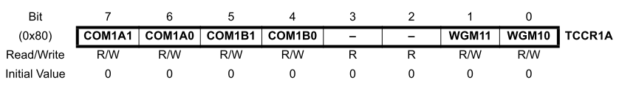
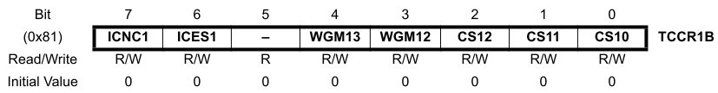
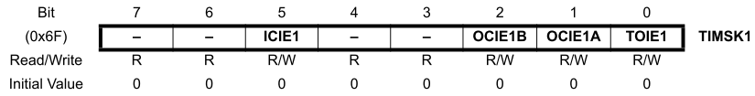
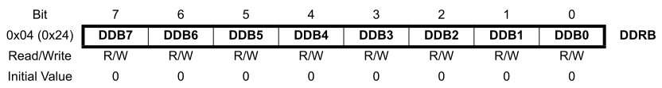
Fast PWM Mode
Set registers
TCCR1A
TCCR1B
TIMSK1
DDRB
Set values
ICR1
OCR1A

Slide 24
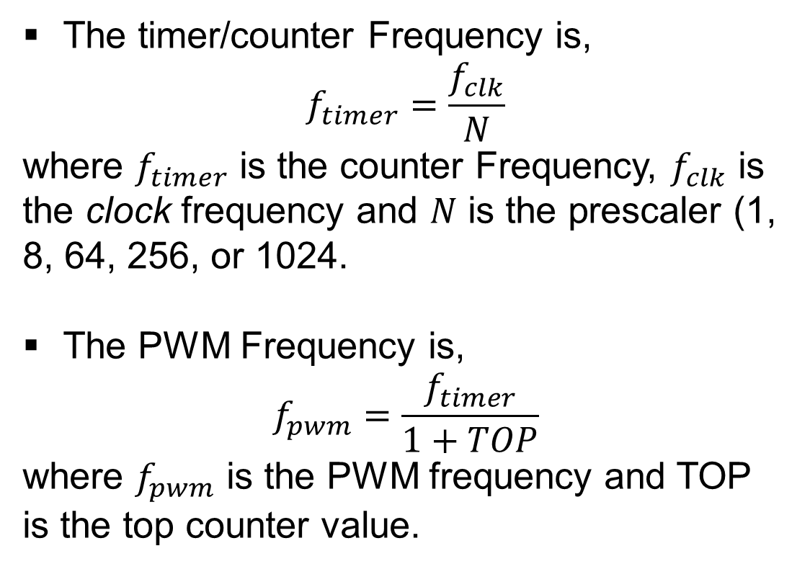

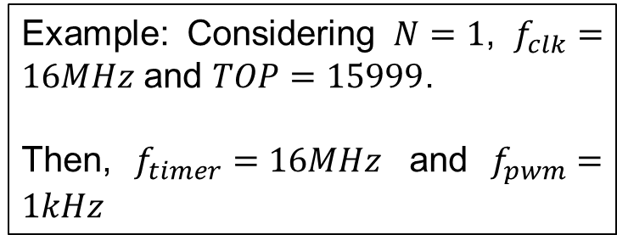

Clock Select/prescaler (TCCR1B)
Counter
TOP
The timer/counter Frequency is,
$$f_{timer}=\frac{f_{clk}}{N}$$
where $f_{timer}$ is the counter Frequency, $f_{clk}$ is the clock frequency and $N$ is the prescaler (1, 8, 64, 256, or 1024.
The PWM Frequency is,
$$f_{pwm}=\frac{f_{timer}}{1+TOP}$$
where $f_{pwm}$ is the PWM frequency and TOP is the top counter value.
$$T_{timer}$$
$$T_{pwm}$$
Example: Considering $N=1$, $f_{clk}=16MHz$ and $TOP=15999$.
Then, $f_{timer}=16MHz$ and $f_{pwm}=1kHz$

Slide 25
Bit masking
Bit Masking is a technique used to manipulate specific bits within a register without altering the others.
REGISTER |= (1 << BIT);
Enable a bit (set to 1)
REGISTER &=~(1 << BIT);
Disable a bit (set to 0)
Keeps the other bits unchanged.
Uses bitwise OR (|=).
Keeps the other bits unchanged.
Uses bitwise AND (&=) and NOT (~).

Slide 26
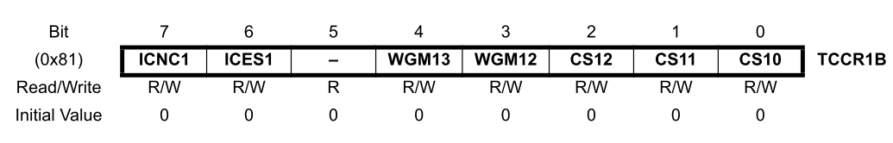
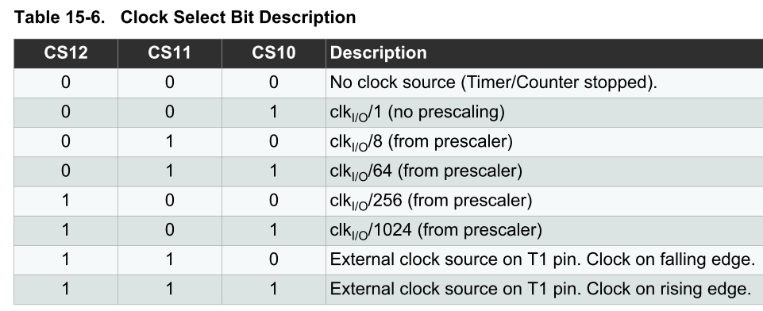
Clock Select/prescaler (TCCR1B)
Supose the prescaler =1, then In order to set:
CS10 = 1
CS11 = 0
CS12 = 0
Using bit masking
// CS12, CS11, CS10
TCCR1B &= ~(1 << CS12);
TCCR1B &= ~(1 << CS11);
TCCR1B |= (1 << CS10);

Slide 27
Clock Select/prescaler (TCCR1B)
Function definition
Use case
void setPrescaler(int prescaler) {
TCCR1B &= ~(1 << CS12);
TCCR1B &= ~(1 << CS11);
TCCR1B &= ~(1 << CS10);
switch (prescaler) {
case 1:
TCCR1B |= (1 << CS10); // Prescaler = 1
break;
case 8:
TCCR1B |= (1 << CS11); // Prescaler = 8
break;
case 64:
TCCR1B |= (1 << CS11) | (1 << CS10); // Prescaler = 64
break;
case 256:
TCCR1B |= (1 << CS12); // Prescaler = 256
break;
case 1024:
TCCR1B |= (1 << CS12) | (1 << CS10); // Prescaler = 1024
break;
default:
// Valor inválido, desativa o Timer1
TCCR1B &= ~( (1 << CS12) | (1 << CS11) | (1 << CS10) );
break;
}
}
void setup(){
(…)
// Prescaler = 1
setPrescaler(1);
(…)
}

Slide 28
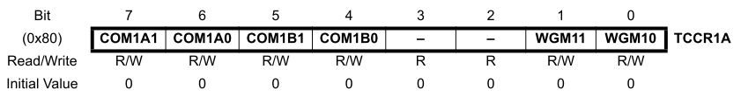
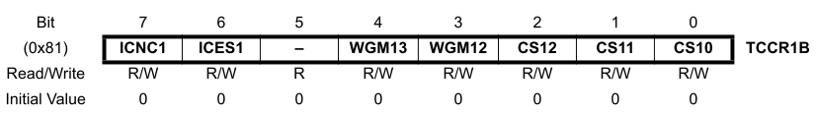
Waveform Generation Mode
Two registers (TCCR1A and TCCR1B) controls the WGM.
In TCCR1A bits: 0 and 1
In TCCR1B bits: 3 and 4

Slide 29
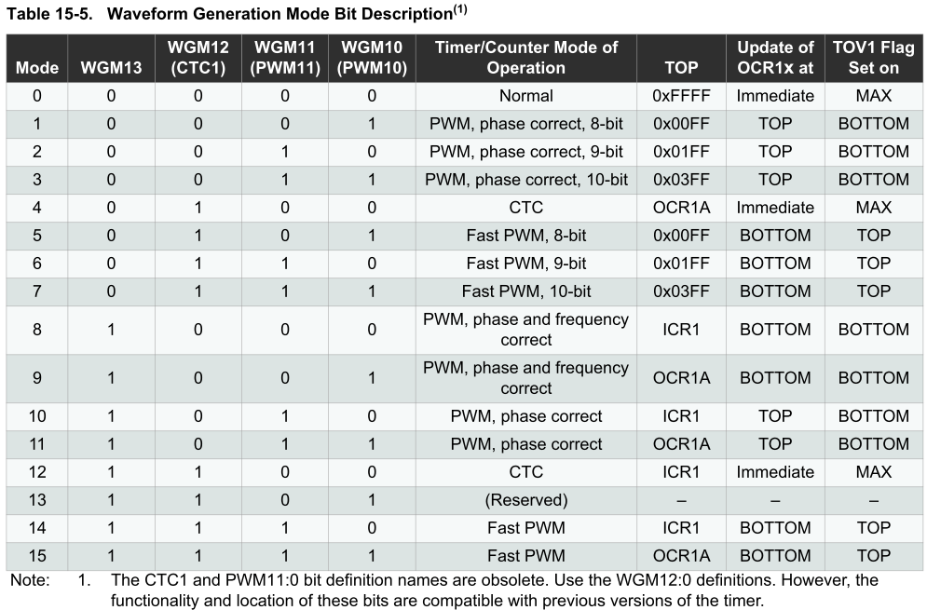
Waveform Generation Mode
Mode 14 (Fast PWM, TOP = ICR1) → The timer counts down to ICR1 and then restarts.
Using bit masking:
TCCR1A &= ~(1 << WGM10); // 0
TCCR1A |= (1 << WGM11); // 1
TCCR1B |= (1 << WGM12); // 1
TCCR1B |= (1 << WGM13); // 1

Slide 30
Waveform Generation Mode
Function definition
Use case
void setWaveformGenerationMode(int mode) {
// Limpa os bits WGM13, WGM12, WGM11 e WGM10
TCCR1A &= ~(1 << WGM11);
TCCR1A &= ~(1 << WGM10);
TCCR1B &= ~(1 << WGM13);
TCCR1B &= ~(1 << WGM12);
switch (mode) {
case 0: // Mode 0
break;
case 1: // PWM, Phase Correct 8-bit
TCCR1A |= (1 << WGM10);
break;
(…)
case 14: // Fast PWM (TOP = ICR1)
TCCR1A |= (1 << WGM11);
TCCR1B |= (1 << WGM12) | (1 << WGM13);
break;
case 15: // Fast PWM (TOP = OCR1A)
TCCR1A |= (1 << WGM11) | (1 << WGM10);
TCCR1B |= (1 << WGM12) | (1 << WGM13);
break;
default:
break;
}
}
void setup(){
(…)
// Mode 14
setWaveformGenerationMode(14);
(…)
}

Slide 31
Set top counter
Function definition
Use case
int setTopCounter(int top) {
if (top < 0 || top > 65535) {
return 0;
} else {
ICR1 = top;
return 1;
}
}
void generateLookupTable() {
for (int n = 0; n < lookupSize; n++) {
lookupSin[n] = sin(2 * M_PI * n / Ns);
}
}
double ma = 0.6;
const double fo = 60.0;
const double mf = 200.0;
const double fclk = 16e6;
const int N = 1;
const double ftimer = fclk / N;
const double fpwm_target = mf * fo;
const int TOP = ceil(ftimer / fpwm_target - 1);
const double fpwm = ftimer / (N * (1 + TOP));
const double Tpwm = 1.0 / fpwm;
const double To = 1.0 / fo;
const int Ns = ceil(To / Tpwm);
const int lookupSize = Ns;
double lookupSin[lookupSize];
volatile bool isInterrupt = false;
static int index = 0;
bool isPwmBipolar = true;
bool isPwmUnipolar = false;
void setup(){
(…)
setTopCounter(TOP);
generateLookupTable();
(…)
}

Slide 32
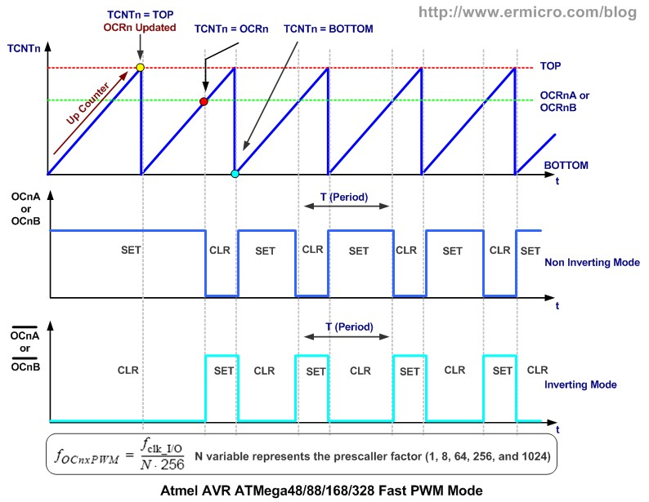










Inverting and non-inverting
Non-inverting:
Inverting:
$$D=OCRnx$$
$$g=OCnx$$
$$+$$
$$v_{tri}=TCNTn$$
$$−$$
$$D=OCRnx$$
$$g=OCnx$$
$$+$$
$$v_{tri}=TCNTn$$
$$−$$

Slide 33
Inverting and non-inverting
Fast PWM (adjust TCCR1A):
COM1A1, COM1A0, relates to OC1A (PB1 or Arduino pin 9)
COM1B1, COM1B0, relates to OC1B (PB2 or Arduino pin 10)
COM1A1 COM1B1 | COM1A0 COM1B0 | Description
0 | 0 | OC1A/OC1B disconnected.
0 | 1 | Toggle OC1A/OC1B on Compare Match
1 | 0 | set OC1A/OC1B at non-inverting mode
1 | 1 | Set OC1A/OC1B at inverting mode

Slide 34
Inverting and non-inverting
Examples:
OC1A and OC1B no inverting
OC1A and OC1B inverting
TCCR1A &= ~(1 << COM1A0); // 0
TCCR1A |= (1 << COM1A1); // 1
TCCR1A &= ~(1 << COM1B0); // 0
TCCR1A |= (1 << COM1B1); // 1
TCCR1A |= (1 << COM1A0); // 1
TCCR1A |= (1 << COM1A1); // 1
TCCR1A |= (1 << COM1B0); // 1
TCCR1A |= (1 << COM1B1); // 1

Slide 35
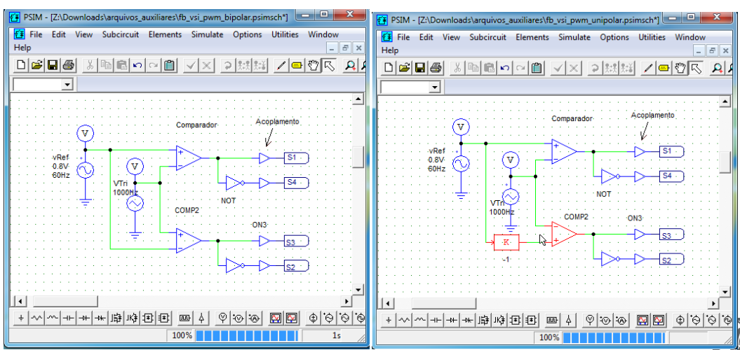
Unipolar and Bipolar PWM

Slide 36
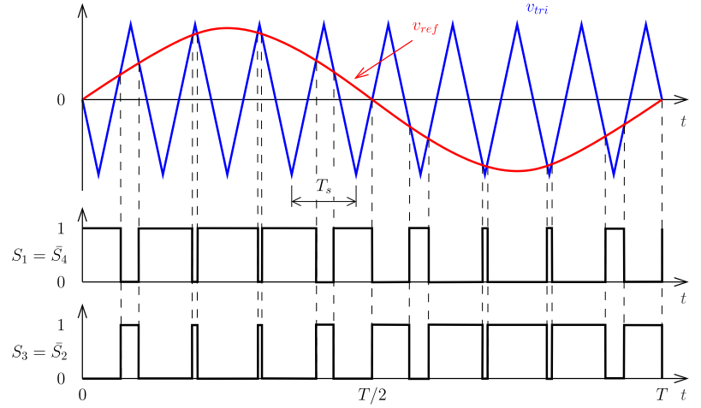
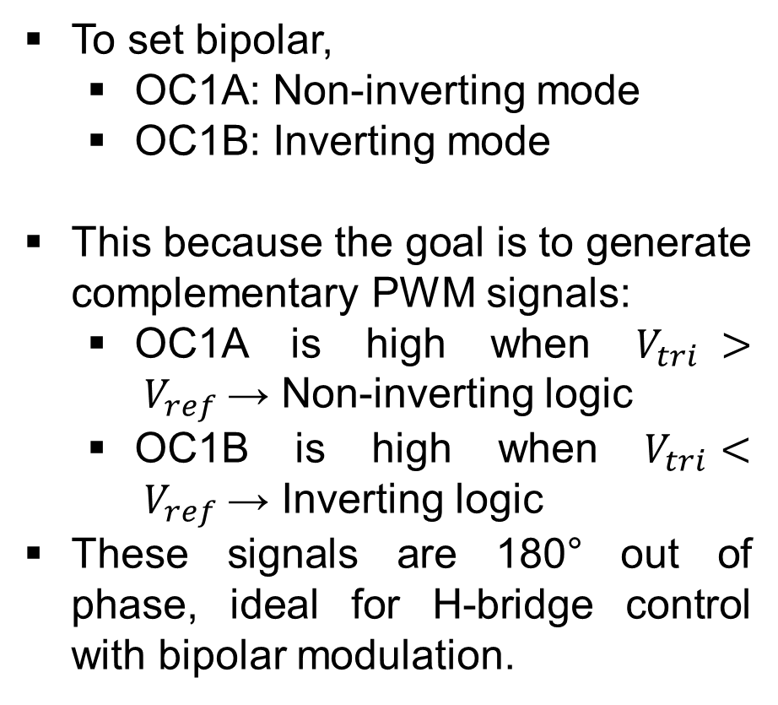
Bipolar PWM
To set bipolar,
OC1A: Non-inverting mode
OC1B: Inverting mode
This because the goal is to generate complementary PWM signals:
OC1A is high when $V_{tri} > V_{ref}$→ Non-inverting logic
OC1B is high when $V_{tri}< V_{ref}$→ Inverting logic
These signals are 180° out of phase, ideal for H-bridge control with bipolar modulation.

Slide 37
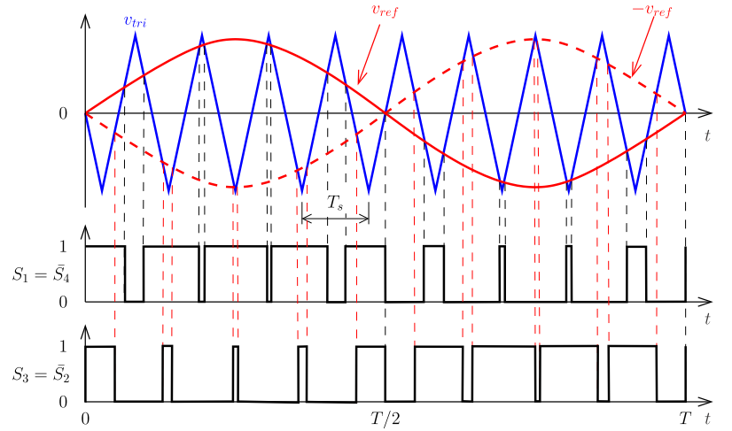
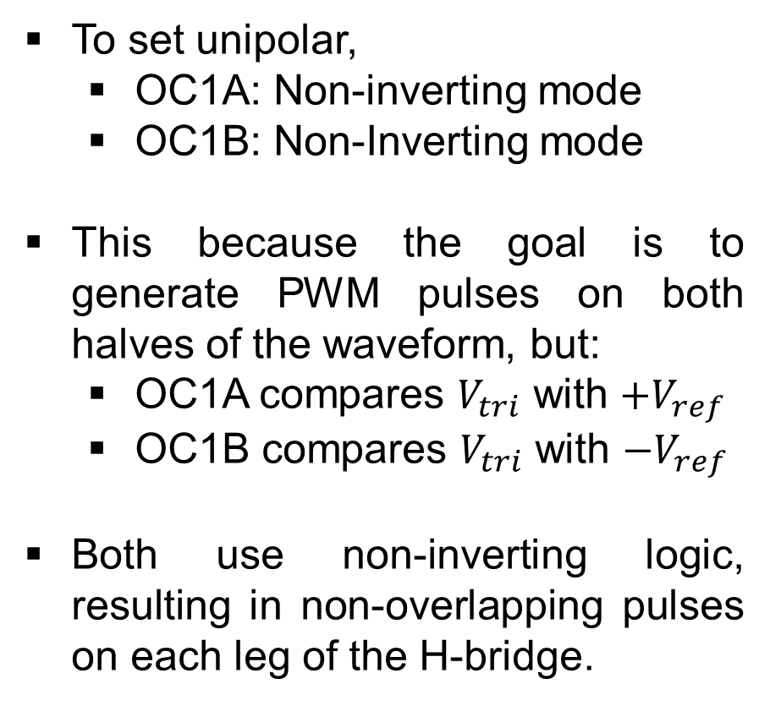
Unipolar PWM
To set unipolar,
OC1A: Non-inverting mode
OC1B: Non-Inverting mode
This because the goal is to generate PWM pulses on both halves of the waveform, but:
OC1A compares $V_{tri}$ with $+V_{ref}$
OC1B compares $V_{tri}$ with $−V_{ref}$
Both use non-inverting logic, resulting in non-overlapping pulses on each leg of the H-bridge.

Slide 38
Bipolar or unipolar
Function definition
Use case
void setPWMPinMode(int channel, bool isInverting) {
if (channel == 1) { // pin OC1A (pin 9)
TCCR1A &= ~(1 << COM1A1);
TCCR1A &= ~(1 << COM1A0);
if (inverting) {
// Inverting mode for OC1A
TCCR1A |= (1 << COM1A1) | (1 << COM1A0);
} else {
// Non-Inverting mode for OC1A
TCCR1A |= (1 << COM1A1);
}
}
else if (channel == 2) { // pin OC1B (pin 10)
TCCR1A &= ~(1 << COM1B1);
TCCR1A &= ~(1 << COM1B0);
if (inverting) {
// Inverting mode for OC1B
TCCR1A |= (1 << COM1B1) | (1 << COM1B0);
} else {
// Non-Inverting mode for OC1B
TCCR1A |= (1 << COM1B1);
}
}
}
void setup(){
(…)
if (isPwmBipolar)
{
// Non-inverting mode for OC1A
setPWMPinMode(1, true);
// Inverting mode for OC1B
setPWMPinMode(2, false);
}
if (isPwmUnipolar)
{
// Non-inverting mode for OC1A
setPWMPinMode(1, false);
// Non-inverting mode for OC1B
setPWMPinMode(2, false);
}
(…)
}

Slide 39
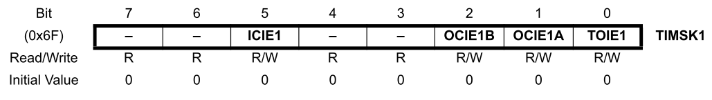
Enable interruptions
In this application, interrupts are used to dynamically update the values of OCR1A and OCR1B (sine wave samples, as mentioned).
Since the PWM frequency (fs) is much higher than the fundamental frequency of the waveform (fo), the timing error introduced by discrete updates can be considered negligible.
However, it is also possible to use Compare Match A and B interrupts to achieve more precise updates — at the cost of higher energy consumption due to increased interrupt handling.
Bit | Function | Usage in PWM
ICIE1 | Triggers interrupt when TCNT1 is captured via ICP1 pin | Not used in this case, set to 0
OCIE1B | Triggers interrupt when TCNT1 == OCR1B | Not used in this case, set to 0
OCIE1A | Triggers interrupt when TCNT1 == OCR1A | Not used in this case, set to 0
TOIE1 | Triggers interrupt when TCNT1 overflows (0xFFFF → 0x0000) | Not used in this case, set to 1

Slide 40
Enable interruptions
Function definition
Use case
void setTimer1Interrupt(bool doOverflow, bool doMatchA, bool doMatchB) {
TIMSK1 &= ~((1 << TOIE1) | (1 << OCIE1A) | (1 << OCIE1B)); if (doOverflow) {
// Enables overflow interruption
TIMSK1 |= (1 << TOIE1); }
if (doMatchA) {
// Enables Compare Match A (OCR1A) interruption
TIMSK1 |= (1 << OCIE1A); }
if (doMatchB) {
// Enables Compare Match B (OCR1B) interruption
TIMSK1 |= (1 << OCIE1B); }
}
void setup(){
(…)
// Enabling overflow interruption
setTimer1Interrupt(true, false, false);
sei(); // Enable global interrupts.
(…)
}

Slide 41
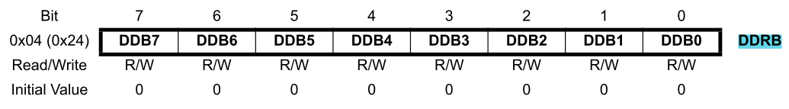
Input/output definition
Pins D9 (OC1A) and D10 (OC1B), controlled by Timer1, must be configured as outputs using the DDRB register to allow the timer hardware to generate PWM signals on these pins.
The Data Direction Register B (DDRB) controls whether each pin on PORTB (Arduino pins D8 to D13) is set as input (0) or output (1).
Each bit in DDRB corresponds to one pin:
DDB1 → PB1 → Arduino D9 → PWM (OC1A)
DDB2 → PB2 → Arduino D10 → PWM (OC1B)
Bit | Pin (PORTB) | Arduino Pin | Direction Control | PWM Support
DDB7 | — | — | Not used / Not mapped | —
DDB6 | — | — | Not used / Not mapped | —
DDB5 | PB5 | D13 | Onboard LED | ❌
DDB4 | PB4 | D12 | Digital I/O | ❌
DDB3 | PB3 | D11 | OC2A | ✅ (Timer2 - OC2A)
DDB2 | PB2 | D10 | OC1B | ✅ (Timer1 - OC1B)
DDB1 | PB1 | D9 | OC1A | ✅ (Timer1 - OC1A)
DDB0 | PB0 | D8 | Digital I/O | ❌

Slide 42
Input/output definition
Function definition
Use case
void setDDRBPin(int arduinoPin, bool isOutput) {
int bit = -1;
switch (arduinoPin) {
case 8: bit = 0; break; // PB0
case 9: bit = 1; break; // PB1
case 10: bit = 2; break; // PB2
case 11: bit = 3; break; // PB3
case 12: bit = 4; break; // PB4
case 13: bit = 5; break; // PB5
} if (bit == -1) return; if (isOutput) {
DDRB |= (1 << bit); // output
} else {
DDRB &= ~(1 << bit); // input
}
}
void setup(){
(…)
setDDRBPin(9, true);
setDDRBPin(10, true);
(…)
}

Slide 43
Overview
Presetting
Setup
#include <avr/io.h>
#include <avr/interrupt.h>
#include <math.h>
double ma = 0.6;
const double fo = 60.0;
const double mf = 200.0;
const double fclk = 16e6;
const int N = 1;
const double ftimer = fclk / N;
const double fpwm_target = mf * fo;
const int TOP = ceil(ftimer / fpwm_target - 1);
const double fpwm = ftimer / (N * (1 + TOP));
const double Tpwm = 1.0 / fpwm;
const double To = 1.0 / fo;
const int Ns = ceil(To / Tpwm);
const int lookupSize = Ns;
double lookupSin[lookupSize];
volatile bool isInterrupt = false;
static int index = 0;
bool isPwmBipolar = true;
bool isPwmUnipolar = false;
void setup()
{
setPrescaler(1);
setWaveformGenerationMode(14);
if (isPwmBipolar)
{
setPWMPinMode(1, true); // Non-inverting mode for OC1A
setPWMPinMode(2, false); // Inverting mode for OC1B
}
if (isPwmUnipolar)
{
setPWMPinMode(1, false); // Non-inverting mode for OC1A
setPWMPinMode(2, false); // Non-inverting mode for OC1B
}
setTimer1Interrupt(true, false, false);
setDDRBPin(9, true);
setDDRBPin(10, true);
setTopCounter(TOP);
generateLookupTable();
sei(); // Enable global interrupts.
}

Slide 44
Overview
Loop
Functions
void loop()
{
if (isInterrupt)
{
if ( isPwmBipolar )
{
OCR1A = ( TOP/2 ) * (ma * lookupSin[index] + 1);
OCR1B = ( TOP/2 ) * (ma * lookupSin[index] + 1);
index++;
if (index >= lookupSize) index = 0;
}
if ( isPwmUnipolar )
{
OCR1A = ( TOP/2 ) * ( ma * lookupSin[index] + 1);
OCR1B = ( TOP/2 ) * ( - ma * lookupSin[index] + 1);
index++;
if (index >= lookupSize) index = 0;
}
isInterrupt = false;
}
}
void generateLookupTable()
void setPrescaler(int prescaler)
void setWaveformGenerationMode(int mode)
void setPWMPinMode(int channel, bool isInverting)
void setTimer1Interrupt(bool doOverflow, bool doMatchA, bool doMatchB)
void setDDRBPin(int arduinoPin, bool isOutput)
int setTopCounter(int top)

